Slide 1
Geodetic Acoustic Rays Solutions in the Time Domain
IR&D Phase I Status + Phase II Proposed Work
May 16, 2006
Rob Goff, Sector Manager
John Bell, Division Manager
Sean Reilly, Principal Investigator (401) 841-7219
Matt Nowicki, Group Controller (757) 240-5358

Slide 2
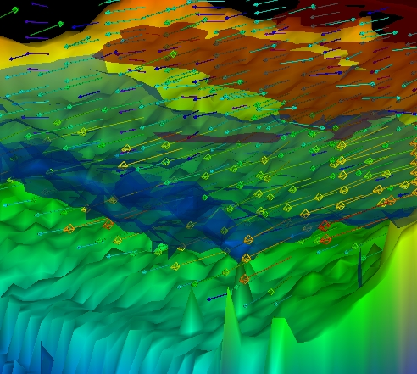
Product Concept
Development State: Proof of Concept
A faster acoustic model for highly dynamic simulations, based on prior works in the field and reworked into an innovative, high performance, time-domain, 3-D processing model optimized for the littoral environments and tactics of current interest to the Navy.
Water Column Visualization

Slide 3
Market Characteristics – Customer / Value
Anticipated Customers/Customer Base
  US Navy
    Simulation Community
    Research Community
Value to Customer
  Acoustic Modeling in areas not covered by precursor models, principally high performance broadband 3-D modeling in littoral environments.

Slide 4
Technical Overview – Project Objectives
Construct a model that is optimized for littoral environments and tactics of current interest.
Compute full 3-D acoustic propagation to support out-of-plane reflection from the ocean bottom as a principle littoral effect.
Process in the time domain to directly calculate the broadband environment.
Employ Gaussian beam techniques for transmission loss calculation to extend the applicability of ray theory to lower frequency regimes.
Leverage advances in processor architecture and software libraries to achieve performance.
Use IR&D to establish Alion leadership in time domain acoustic modeling.
Interest already established with Navy customers (ONR, NWDC)

Slide 5
Technical Overview - Primary Risk Areas
Reliance on untried software for performance.
  Performance of vector math libraries at speed equivalent to hand-coded DSP libraries.
  Unwrapping of expressions at compile time to optimize performance on pipelined architectures like the Intel Pentium.
Ability to achieve appropriate design tradeoffs among accuracy, performance, etc.
Project Planning – incremental funding/short term scheduling a departure from original proposal

Slide 6
Product Development – General
No available defrayed costs.
No third party participants required
Critical Staffing
  Analyst / Investigator
  Programmer
No Use of Existing Intellectual Property
Potentially Generated Intellectual Property
  Conceptual Acoustic Models
  Implementation meeting performance goals
No Intellectual Property Jeopardized

Slide 7
Product Development – Overall Major Elements
Peer Reviewed Theoretical Paper detailing new Acoustic Modeling Concept
Modified build of existing (AtLos) FeyRay code with limited functionality matching new prototype
Implementation of full featured prototype 3-D Geodetic Ray Propagation Engine
Significant performance enhancements via modernization of exiting mathematical support software
T&E against modified build of FeyRay

Slide 8
Product Development – Categorical
Theoretical 3-D Acoustic Model
  Produce peer-reviewed research paper on theory
Implementation
  Hi-Performance Matrix and Vector Math
  Gridded NetCDF Datasets
  3-D Ray Propagation Engine
  Eigenray Estimation
  Gaussian Beam Intensity
  Modified FeyRay Build for T&E
  3-D Visualization
  Compile test results and documentation
Evaluation
  Replicate the results of the 40 SWAM99 test cases for range-dependent acoustic propagation models.
  Produce research paper on evaluation

Slide 9
1st Phase Financials to Date
Approx $66k of original $100k expended
Approx $98k projected expended by 07/01/2006
Expenditure Rate projected as steady $5.1k/wk with no PTO

Slide 10
Product Development – Accomplishments to date
All Peer review necessary to support Phase I,II goals accomplished.
Successfully built preliminary FeyRay ray propagation engine.
Successfully built preliminary 3-D Geodetic ray code for refractive scenario (Munk profile) with stable 2nd order numerical integrator.
Able to process tabulated/interpolated sound speed profile in 3-D Geodetic ray code.
Preliminary versions of C++ code capable of reading and writing NetCDF files consisting of single variables with multiple dimensions.
Preliminary assessment of existing code resources for suitability for Hi-Performance Linear Algebra S/W.

Slide 11
Product Development – Current Phase Remaining Goals
Complete Peer Review by end of May (with some necessary corrections and section rewrites)
Improvements to custom build of existing FeyRay engine as dictated by comparison concerns with new 3-D Geodetic ray code
Improvements to working version of new 3-D Geodetic ray code
Produce Analytical Solutions of new 3-D Geodetic Ray Model
Preliminary comparison the two baseline systems for Performance, Accuracy, etc.

Slide 12
Product Development – Next Phase Planned Goals
Complete work on NetCDF processing detailed in original proposal
Complete work on High Performance Linear Algebra processing detailed in original proposal
Integrate all enhancements into new version of evolving prototype 3-D Geodetic Ray Propagation Engine.
Enhance 3-D Geodetic Ray Propagation Engine for Boundary Reflections
Complete custom build of existing FeyRay engine to match new prototype 3-D Geodetic Ray Propagation Engine.
Perform new round of Performance, Accuracy and other comparisons between the two baseline systems.
Utilize Analytic Solutions of Geodetic Model for T&E

Slide 13
IR&D Investment Request – General
Development Cost $100k
Development Time 40 man wks – 20 calendar wks
Start Date: 01 July 2006
End Date: Mid-Late Nov 2006
Critical Staffing
  Sr Analyst/SWE Full time 20 weeks
  SWE Full time 20 weeks

Slide 14
IR&D Investment Request – Planning
Task | Sr. Analyst | Programmer
Hi-Perf Linear Algebra Dev | 3 wks | 5wks
Boundary Reflections | 3 wks | -
NetCDF DataSets | 3 wks | 8 wks
FeyRay Custom Build | 4 wks | -
Geodetic Ray Prototype Reintegration | 2 wks | 2 wks
Prototype vs. FeyRay T&E | 3 wks | 3 wks
Analyze and Publish Findings | 1 wk | 2 wks
Next Phase Project Planning | 1 wk | -
Total | 20 wks | 20 wks

Slide 15
A Look Ahead - Remaining Goals
Implementation
  Eigenray Estimation
  Gaussian Beam Intensity
  Transmission Loss
  3-D Visualization
  Compile test results and documentation
Evaluation
  Replicate the results of the 40 SWAM99 test cases for range-dependent acoustic propagation models.
  Produce research paper on evaluation

